Slide 1
So you’ve purchased a SAST tool?
Brenton Kohler Jacob Ewers
@kohlerbn @j_ewers
Copyright © 2016, Cigital

Slide 2
What’s all this SAST?
Static Application Security Testing
Vulnerability discovery without executing code
SAST
Poor cypto implementation
Issues in dead/unused code
Hard coded secrets
Vulnerabilities in code that's not externally exposed
DAST
Environment issues
Server configurations
Patch and version issues
Session management problems
Run time privilege issues
DAST & SAST
SQLi
XSS
Path Traversal
Buffer overflow
Response Splitting
http://www.ibm.com/support/knowledgecenter/SSW2NF_9.0.2/com.ibm.ase.help.doc/topics/c_how_correlation_works.html?lang=en

Slide 3


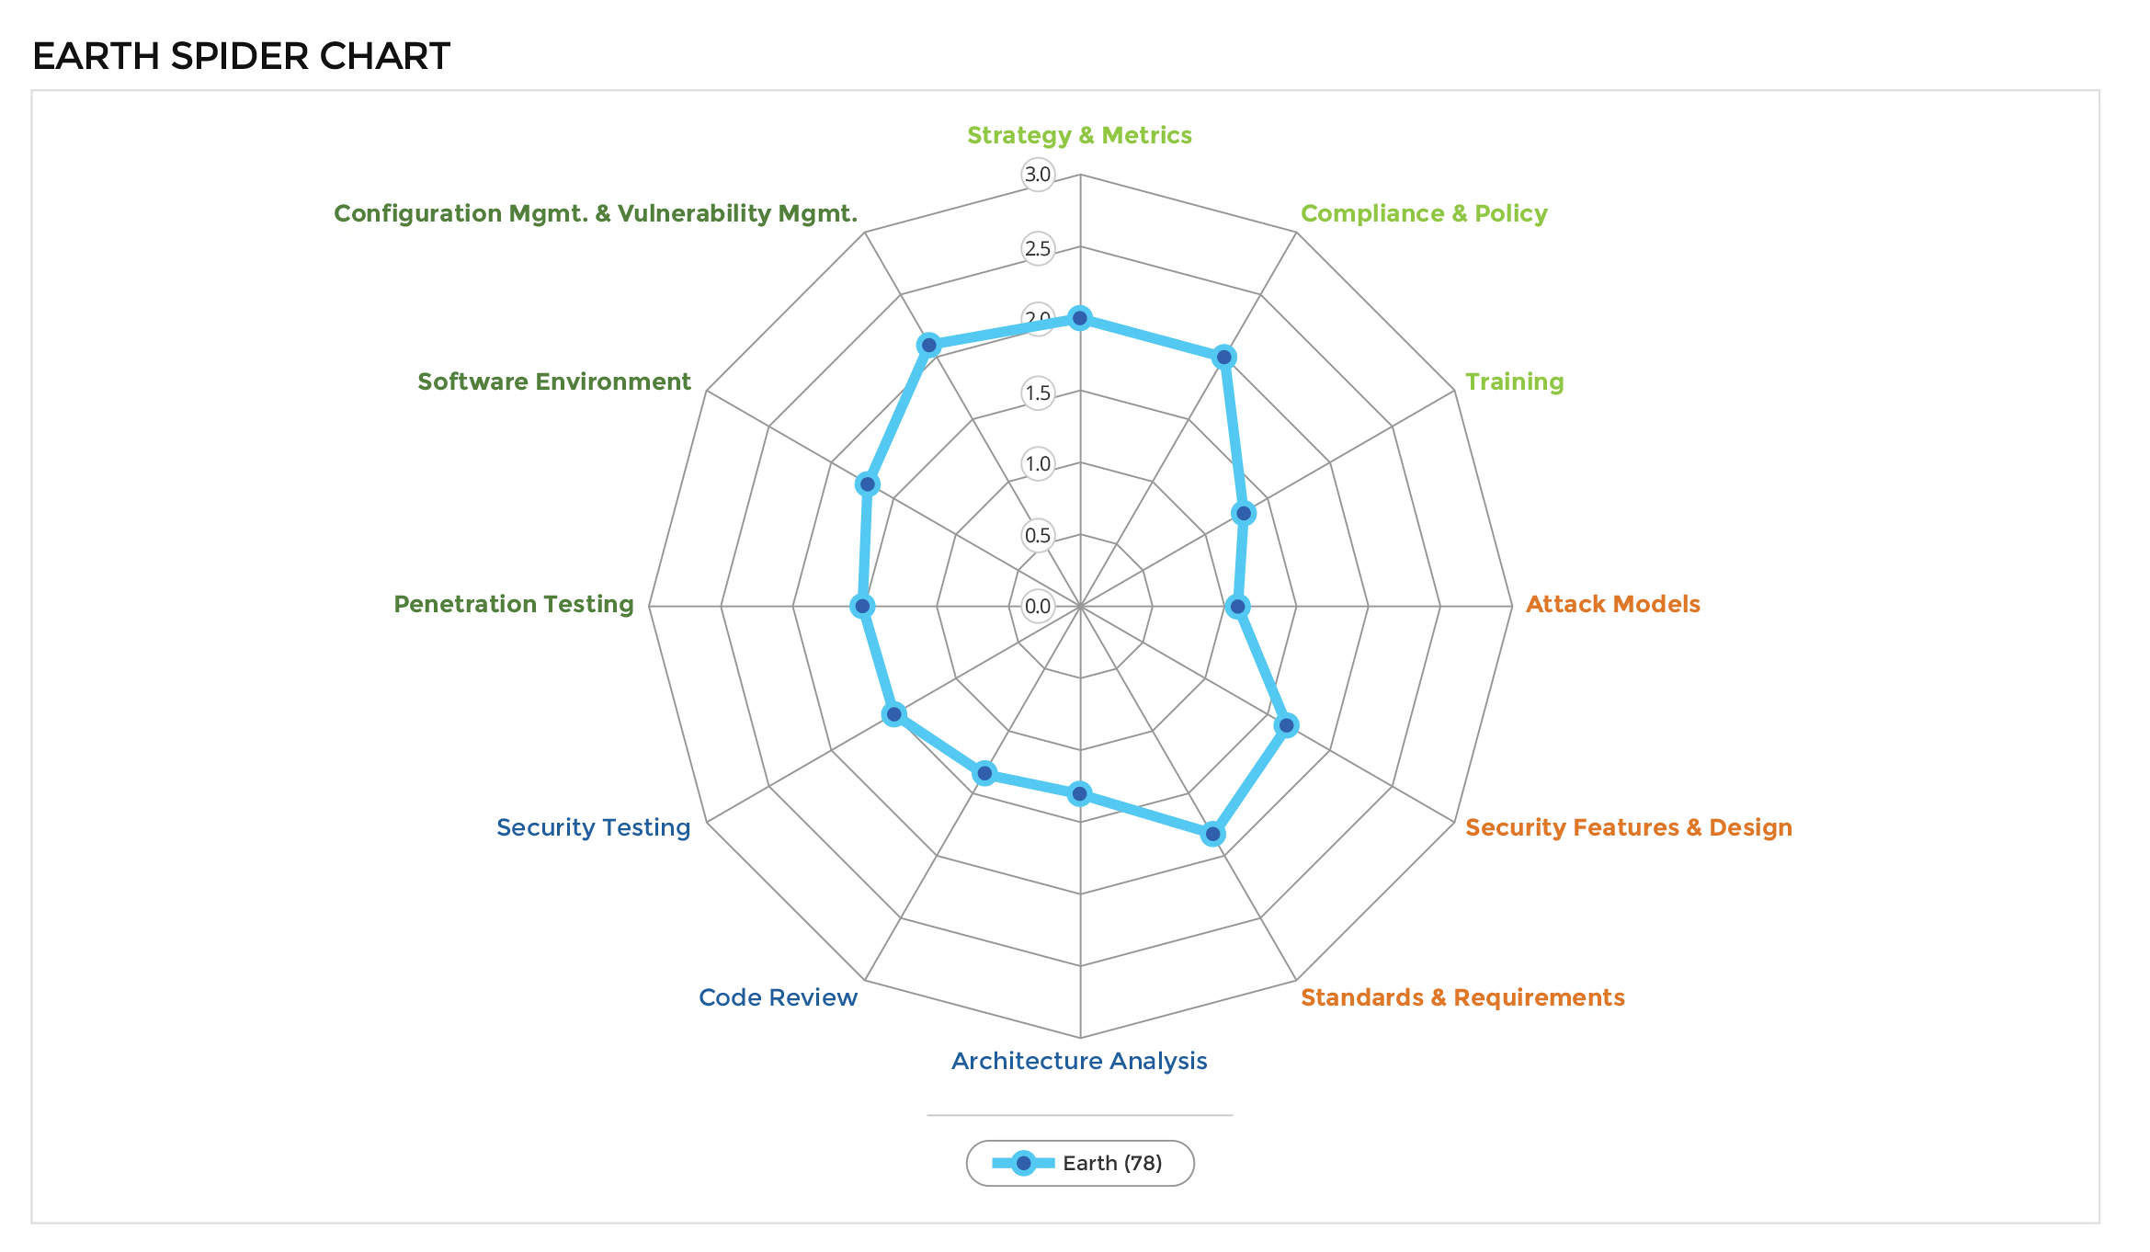
Who’s doing it?
https://bsimm.com

Slide 4
Who’s doing it?
https://bsimm.com
Activity | Observed (78)
CR 1.1 – Use a top N bugs list | 18
CR 1.2 –SSG performs ad hoc reviews | 53
CR 1.4 – Use automated tools | 55
CR 1.5 – Mandatory code reviews | 24
CR 1.6 – Use centralized reporting | 27
CR 2.2 – Enforce coding standards | 7
CR 2.5 – Assign tool mentors | 20
CR 2.6 – Customize the rules | 16
CR 3.2 – Build a factory | 3
CR 3.3 – Eradicate specific bugs | 5
CR 3.4 – Malicious Code Detection | 3

Slide 5
Why does the industry just buy tools?
It’s easy (relatively)
But then, a wall is hit.
“The tool is noisy”
“The tool slows down my developer workflow”

Slide 6
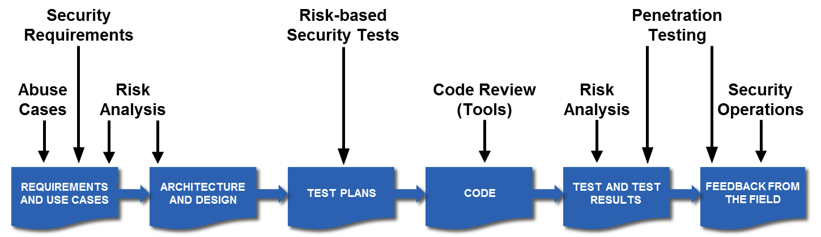
Benefits
“Move left” in the SDLC
Enable developers to change behavior
Provide code-level feedback to aid developers in remediation
Enforce secure coding standards

Slide 7
SAST Truths
Tools out of the box have lots of false positives and false negatives
Deployment model matters.
Each model requires more investment than tool purchase to gain any real values.
We must build people and process around the technology for a mature program.

Slide 8
The Three Tiers of SAST
Tier 1 Prevention |  | Tier 2 Detection |  | Tier 3 Assurance
In-IDE SAST Automated Used by developers day-to-day Identify and fix issues before code check-in |  | In the build process Automated Ran on every build Issues identified before deployment |  | Delivered by security expert Deeper manual review automated with automation for coverage Annual / Biennial based on risk classification Ensure security vulnerabilities are being identified and fixed

Slide 9
Deployment models
Central Service Bureau
Scanning Factory
Build integration
[East coast] Central Service bureau
[Mid west] On-demand SaaS
[West coast] Build Integration / Continuous Integration (CI)

Slide 10
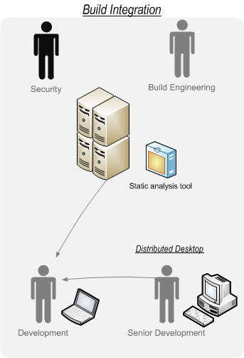
Deployment Models – Build Integration
Pros:
Fast
Works closer to developer workflow
Cons:
Heavy upfront setup for each project
On-boarding of each application
Developers get results directly/Self-reporting

Slide 11
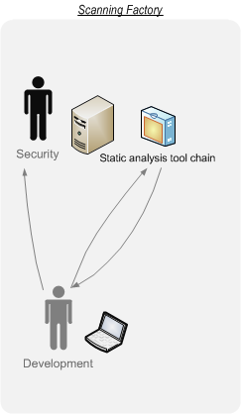
Deployment Models – Scanning Factory
Pros:
Scales security team
Security SME reviewing final results
Application expert working with SAST tool directly
Cons:
Resource limitations – security expertise
Licensing cost
Self-reporting

Slide 12
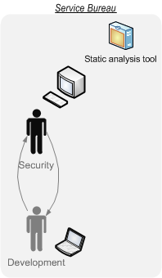
Deployment Models – Service Bureau
Pros:
Limited noise
Security SME on every review
Lowest licensing cost
Cons:
Slowest model for delivery
Resource limitations – security team
Application contextual knowledge lost

Slide 13
How to do it right
Make sure you purchase the correct tool
Deployment models – Desktop, standalone, build integration, SaaS.
Language support – Java, .NET, PHP, JavaScript, SQL, etc.
Integration options – DAST, defect tracking, reporting.
Onboard applications
Scan and Triage
Assign on-going tool mentors
Mature over time
Customize rulepacks to meaningful findings
Automate where possible

Slide 14
Onboarding
Set expectations
Start with the application you know best or most responsive development team
Build the application with the SAST tool
Ensure with the development team you have the full project
Resolve all dependencies
Triage the results

Slide 15
Rulepack Customization – it’s a must!
Multiple rule packs, change them over time
Example: Top N bug list of the organization and update the rule pack to help eradicate bugs. (CR 1.1, 3.3)
Tier 1 Prevention Rule pack |  | Tier 2 Detection Rule pack |  | Tier 3 Assurance Rule pack
Low # of rules Highest criticality vulnerability Highest accuracy rules |  | Middle # of rules A little more permissive as far as criticality More permissive in terms of accuracy |  | Loud and noisy rule pack Allow SME to sort through Provide relevant findings back to development teams directly.

Slide 16
What have we accomplished?
Activity | Just buying a tool | Successfully Deploying
CR 1.1 – Use a top N bugs list
CR 1.2 –SSG performs ad hoc reviews
CR 1.4 – Use automated tools | ✓
CR 1.5 – Mandatory code reviews
CR 1.6 – Use centralized reporting
CR 2.2 – Enforce coding standards
CR 2.5 – Assign tool mentors
CR 2.6 – Customize the rules
CR 3.2 – Build a factory
CR 3.3 – Eradicate specific bugs
CR 3.4 – Malicious Code Detection
Activity | Just buying a tool | Successfully Deploying
CR 1.1 – Use a top N bugs list |  | ✓
CR 1.2 –SSG performs ad hoc reviews
CR 1.4 – Use automated tools | ✓ | ✓
CR 1.5 – Mandatory code reviews |  | ✓
CR 1.6 – Use centralized reporting
CR 2.2 – Enforce coding standards |  | ✓
CR 2.5 – Assign tool mentors
CR 2.6 – Customize the rules |  | ✓
CR 3.2 – Build a factory
CR 3.3 – Eradicate specific bugs |  | ✓
CR 3.4 – Malicious Code Detection

Slide 17
Some thoughts
The big SAST tools are powerful
“There is no silver bullet” – Gary McGraw
A holistic approach to application security is required
Cost to remediate increases the longer a bug remains undiscovered
Qualify, Implement, Mature
People, Process, aaaaaand Technology

